Slide 1
Outsourcing Security
FOIA Requests vs Defense Contracts
Piotr Nojszewski
Zhaoguo Zhu

Slide 2
Background and Motivation
Freedom of Information Act (FOIA) - allows access by the general public to data held by the United States government.
Contracting - outsourcing, a valuable tool for governments, offering a number of advantages.
Outsourcing could save government money but it can also hinder transparency.
Goal - we focused on processing and representing the data in a way that allows statistical analysis between the two datasets.

Slide 3
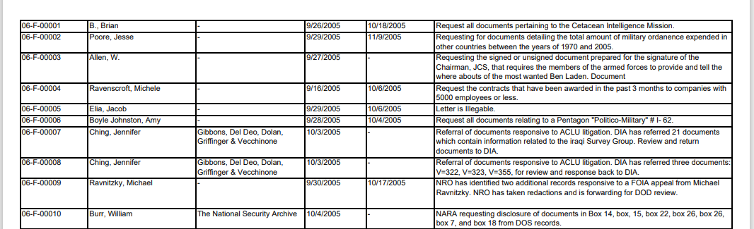
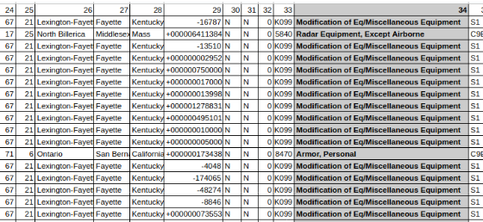
Dataset
FOIA requests data
Contract data pictures

Slide 4
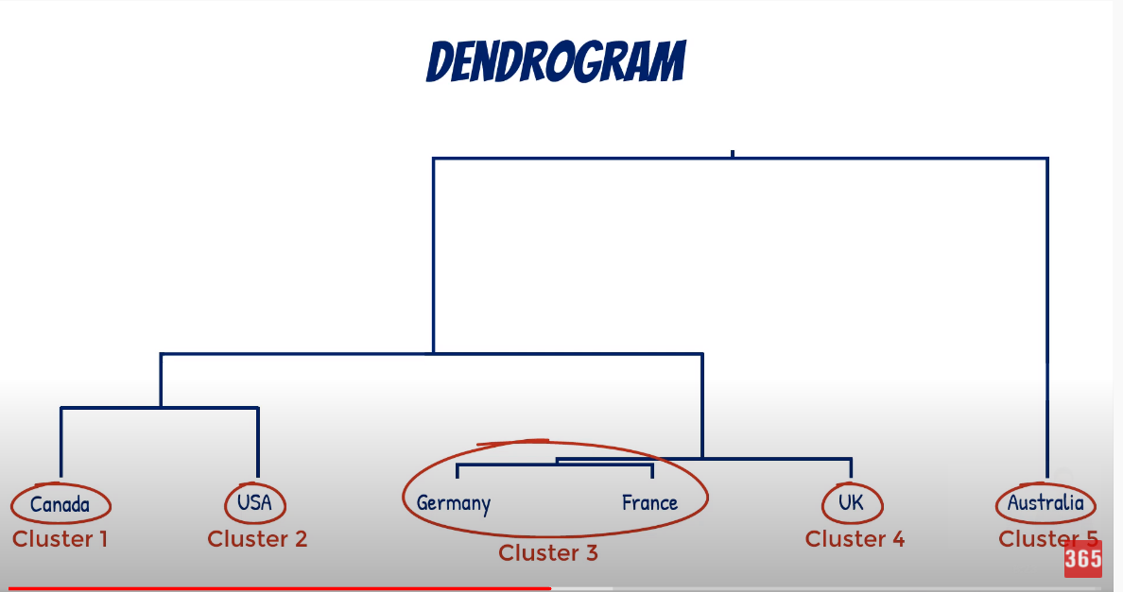
Approach
Cluster FOIA by Hierarchical Agglomerative algorithm and Topic Modeling.
Count contracts by area.
Ct: https://www.youtube.com/watch?v=ijUMKMC4f9I&t=3s

Slide 5
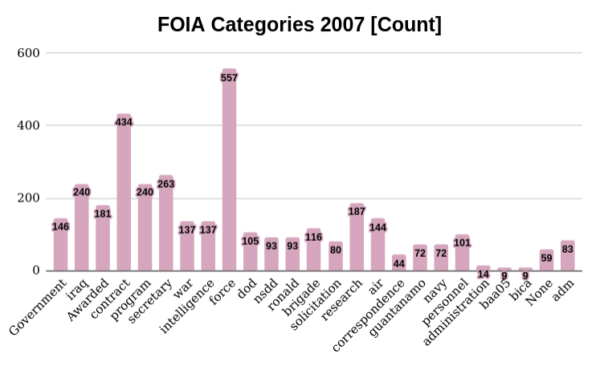
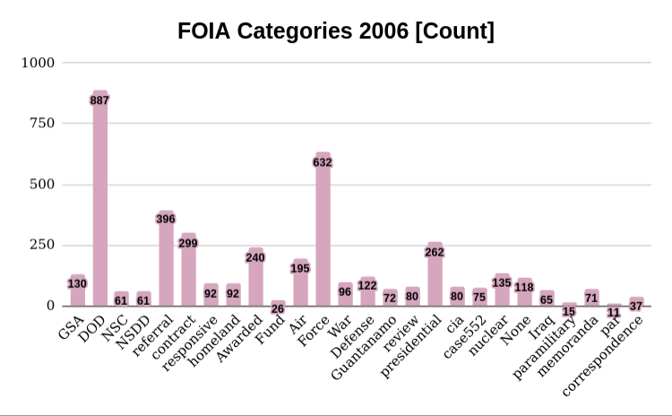
FOIA

Slide 6
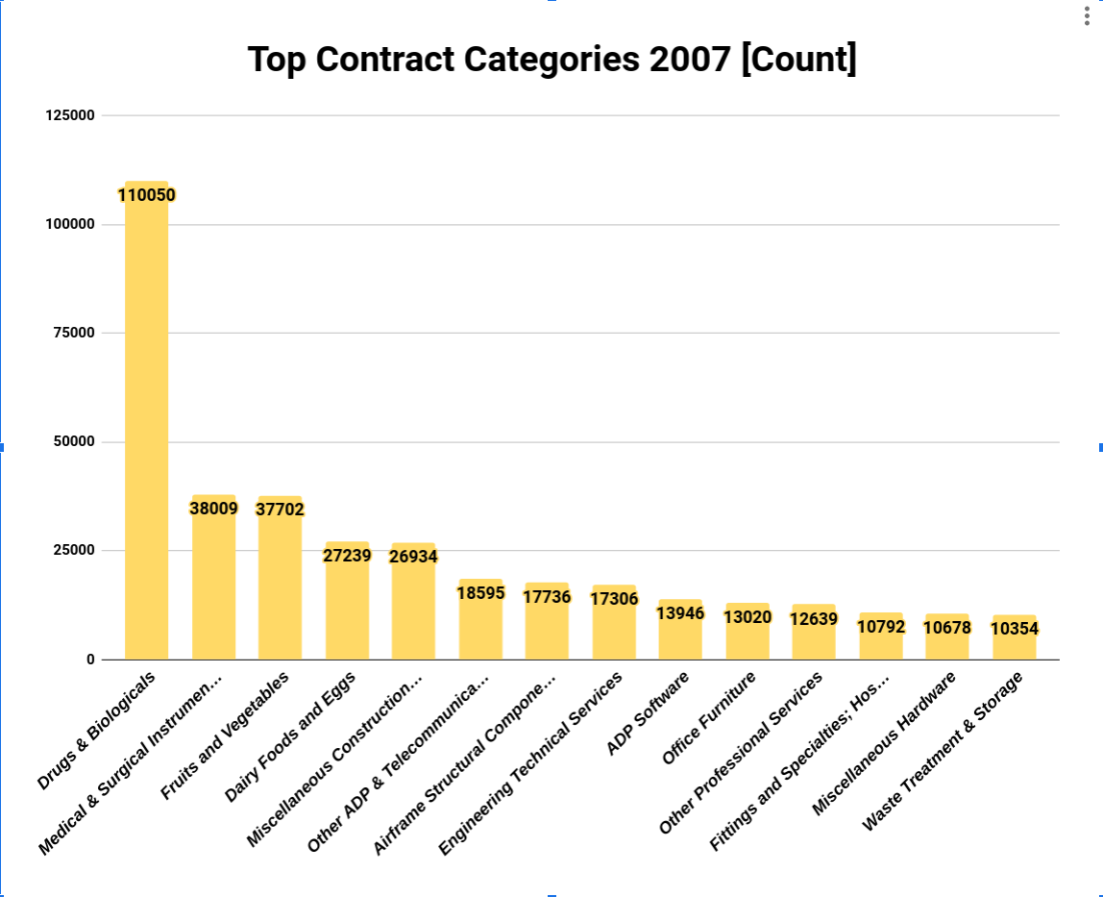
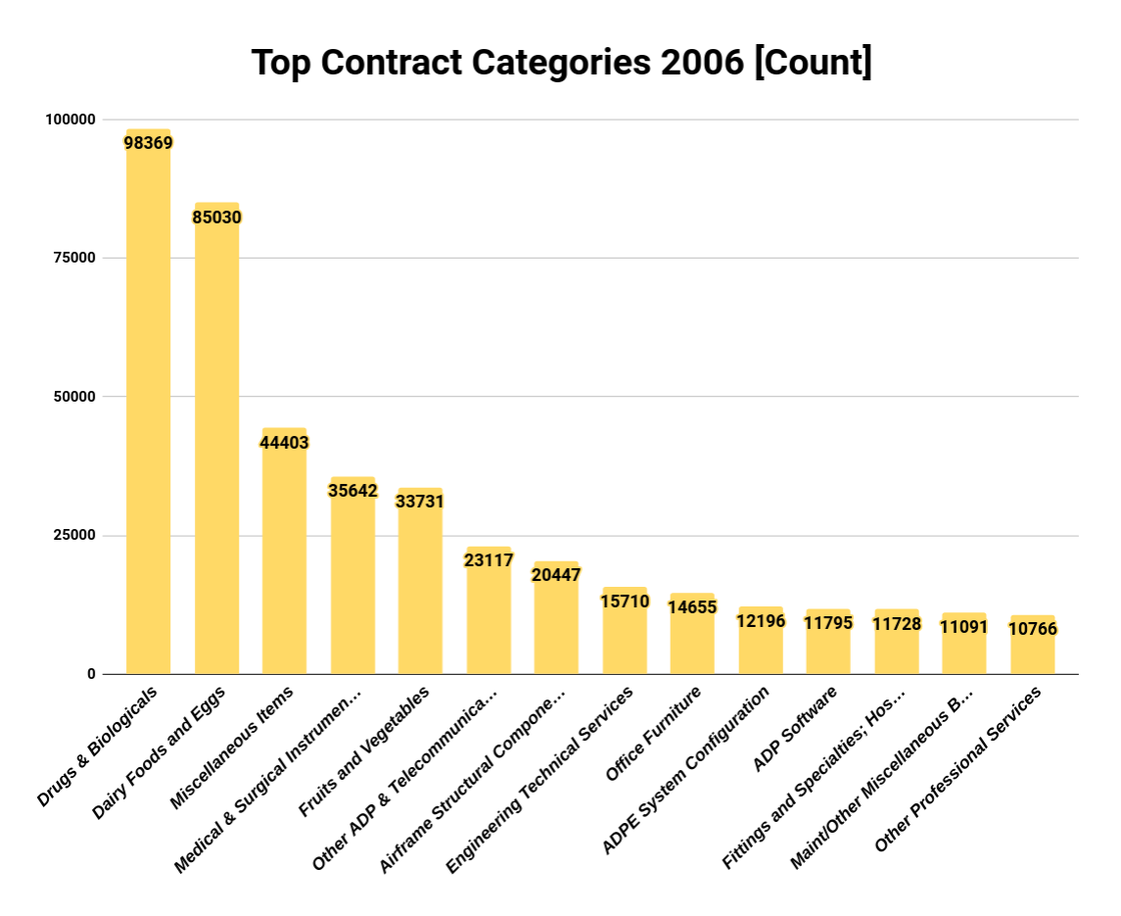
Contract Data

Slide 7
Future Work
Gather FOIA requests from other departments and years of contract data - to get a more comprehensive view.
Investigative work on contract data done by field expert - then patterns in FOIA logs can be used to find correlations

Slide 8
Thank you for attention!
Piotr Nojszewski
Zhaoguo Zhu

